Slide 1
The Restoration Game
James Rhodes, Restoration Manager
Edward Brightman, Restoration Manager

Slide 2
Agenda
Introduction to Tarmac and our approach to quarry restoration
Positive impact sustainable mineral extraction – Langford Q
Continuous improvement and development of best practice
Use of GIS tools: current position and going forward

Slide 3
Tarmac's approach to quarry restoration
UK's leading sustainable construction materials, road contracting and building products business
With over 60,000 acres of land under our stewardship we recognise our duty to manage these assets responsibly and to enable positive outcomes for our business, the community and future generations.
All our extractive sites have Biodiversity Management Plans and Restoration Plans: Minimise impact of quarrying activities and positive impact through habitat creation
39 biodiversity or wildlife partnerships, including 15 sites with the Wildlife Trusts Biodiversity Benchmark certification

Slide 4
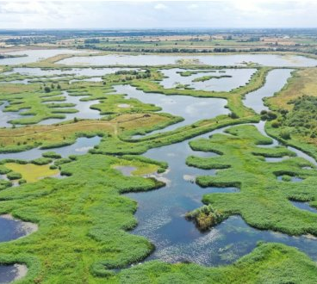
Positive impact sustainable mineral extraction – Langford Q
Langford – Winner of the Cooper-Heyman cup for ‘Best Restoration 2025’ at the 2025 Mineral Products Association Awards
Operating since 1989 providing sand and gravel
Tarmac and RSPB Partnership, gifted to the RSPB.
Long term vision – Identifying the landscape ecology along the river Trent and local nature recovery strategies; benefits to Tarmac and the long-term ongoing partnership; creating an award-winning site.
Using Species to guide a scheme

Slide 5
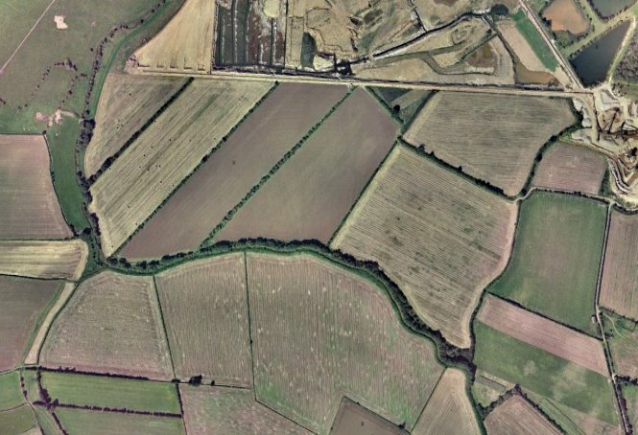
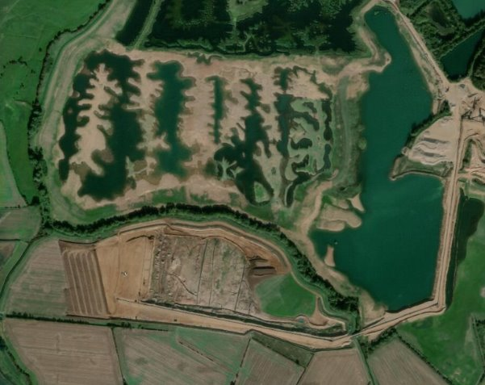
Positive impact sustainable mineral extraction – Langford Q
Before
Development over 20 years
After

Slide 6
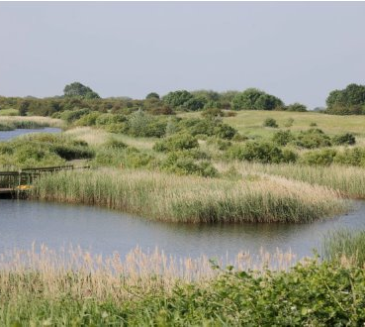
Challenges in Undertaking Quarry Restoration
Right habitat right place, deliverability with consideration of BNG, biodiversity bank
Designing schemes – embracing a ‘messy’ look in the nature rich areas and having flexibility in the scheme.
Incentives for long term management of conservation habitats for Tarmac and landowners
Aftercare – understanding of habitat quality and what can be realistically achieved in the aftercare period.

Slide 7
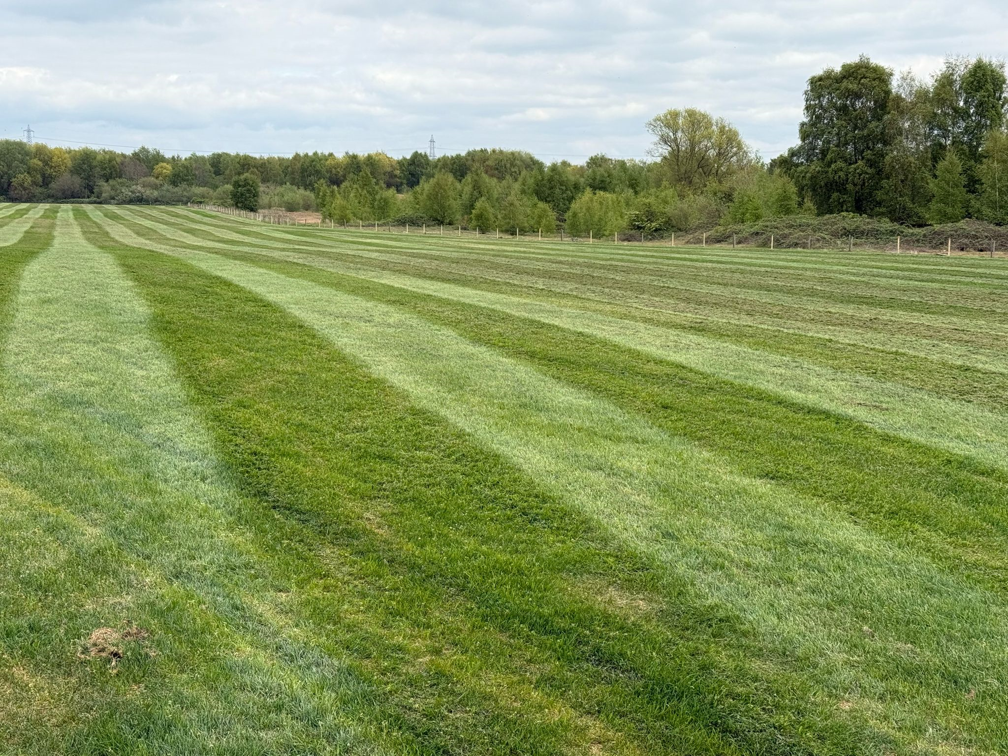
Developing Best Practice – Towards a more sustainable agricultural restoration
Development with agriculture as the end land use
Becoming harder to deliver in flood plains due to increased risk of flooding
Long term we are considering sustainable farming methods on our freehold and with our tenant farmers

Slide 8
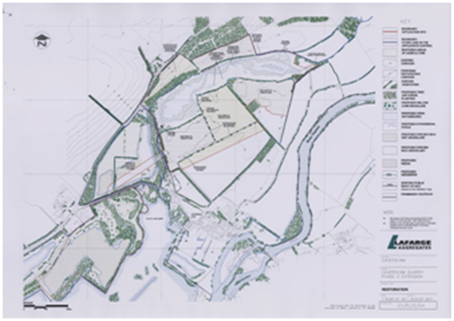
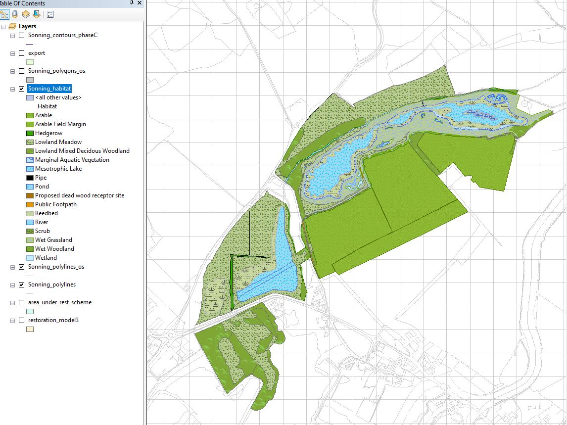
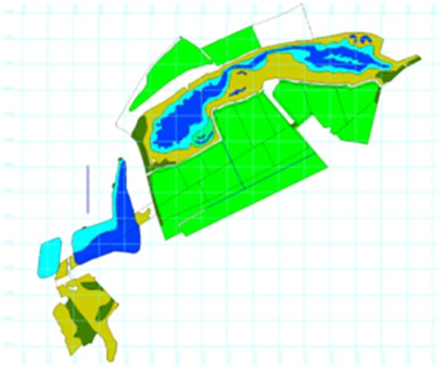
Use of GIS Tools in Restoration
Restoration plans digitised in GIS format.
Integration into our LIS system:
Quick reference for areas and habitats for financial provisioning of restoration works
Accuracy – credibility, visibility, repeatability for corporate reporting
Understanding our impact – Landscape scales – new sites in local and regional context, contrast: before and after.

Slide 9
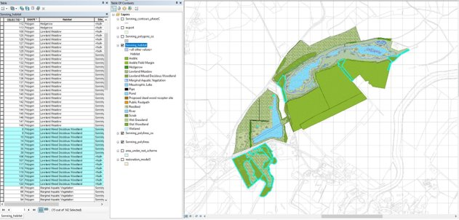
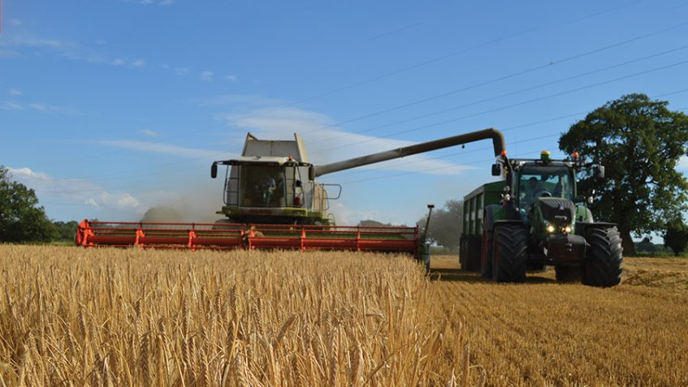
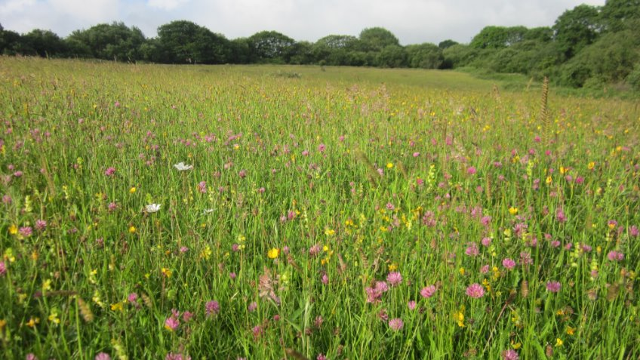
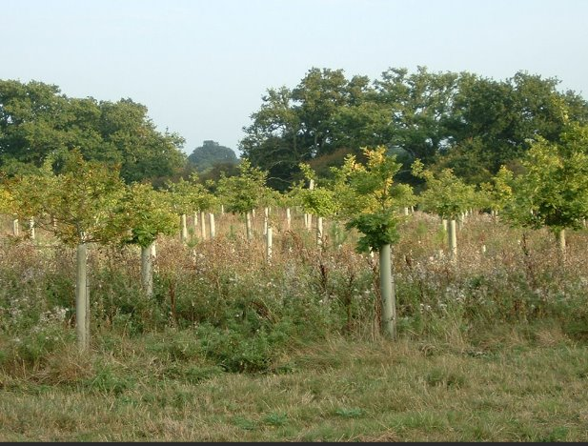
Development going forward:
Automation of environmental reporting
– ESG, Internal and External Communication.
Informed decisions:
Developoment of Strategies
Understanding our portfolio to inform:
Sustainable land stewardship strategies e.g. Farming,
BNG strategy

Slide 10
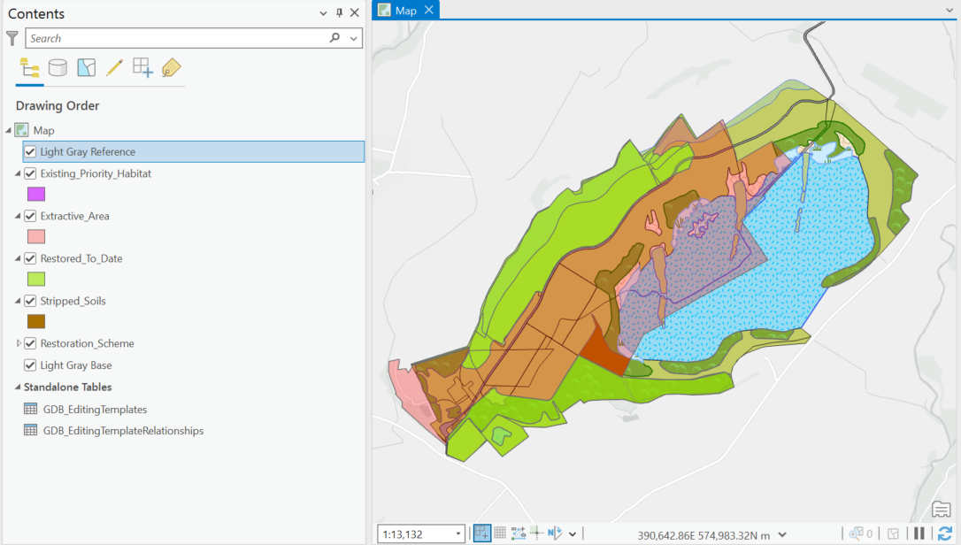
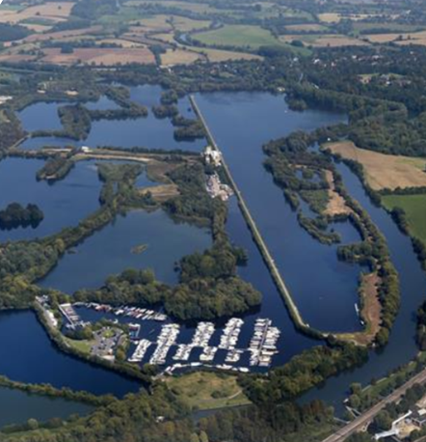
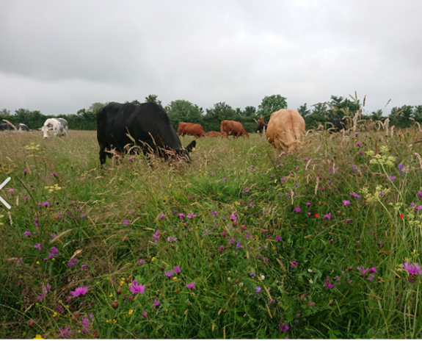
Development going forward...:
Developing internal GIS tools:
Tracking and monitoring systems
- Aftercare delivery
BNG delivery
Habitat creation at landscape scale – linked to nature recovery strategies

