Slide 1
Land Use Consultation
June 2025

Slide 2
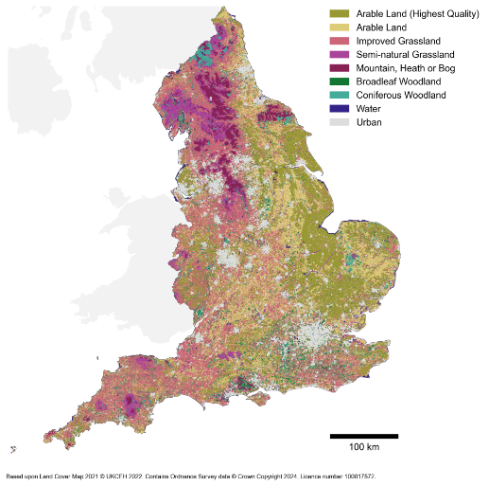
We consulted on a Land Use Framework to enable a land use transition that will support economic growth and nature recovery
Changes in English land use are required to:
Reverse the decline of our natural environment,
Help absorb greenhouse gases,
Adapt to the impacts of climate change, and
Increase the resilience of our food systems, infrastructure, homes and communities. ​
A Land Use Framework will develop and support delivery of a shared vision for English land use

Slide 3
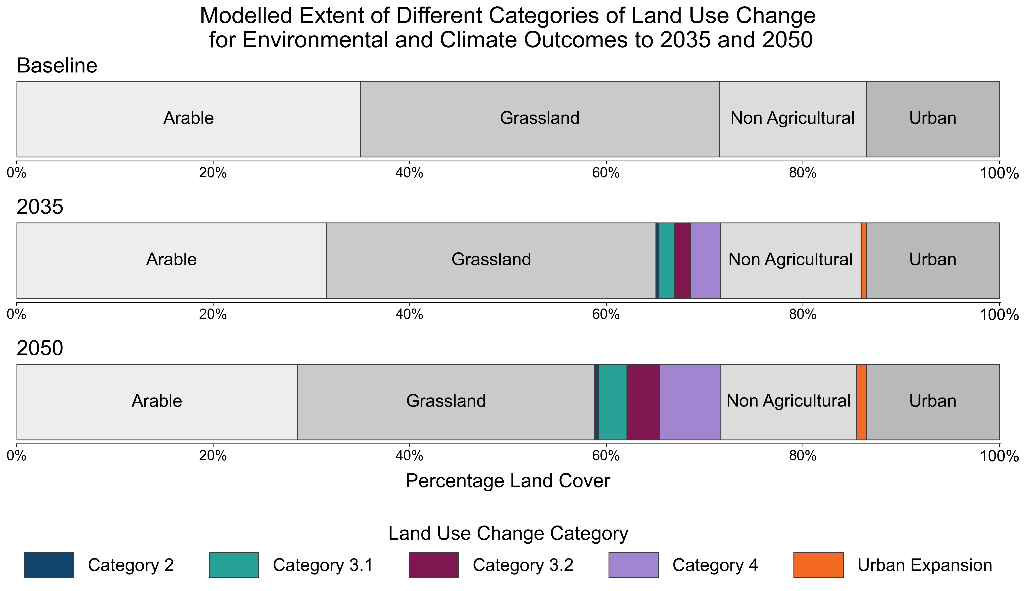
The scale of the transition involves at least 1.6Mha of land use change by 2050, with a diversity of opportunities for land managers
3

Slide 4
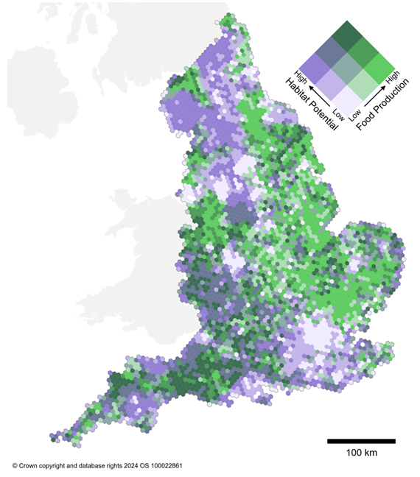
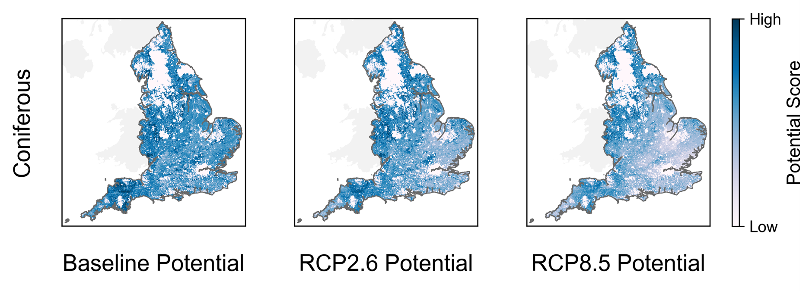
Using our analysis, we consulted on a set of principles to support strategic spatial planning
Assessing land’s strengths
Co-design
Multifunctional land
Playing to the strengths of the land
Decisions fit for the long-term
Responsive by design
Multifunctional landscapes
Present Day Outcomes:
2050 Outcomes:
Considering climate change impacts
4

Slide 5
We sought views on policy changes to address land use challenges
Aligned Incentives
Incentivising changes for long-term food security, increasing private investment into nature-based solutions, making space for nature, bringing nature closer to communities.
Joined-up decisions
Strategic spatial planning for development and infrastructure, connecting plans and strategies, planning for climate resilient land use change
Accessible and high-quality data
Improving land use data, land use data’s interaction with other datasets, understanding land’s capability, reducing data costs where it benefits the public or economy
Supporting land managers with new skills for changing land uses, accelerating sharing of best practice and evidence, sharing lessons from nature restoration and climate adaptation practice
Skills

Slide 6
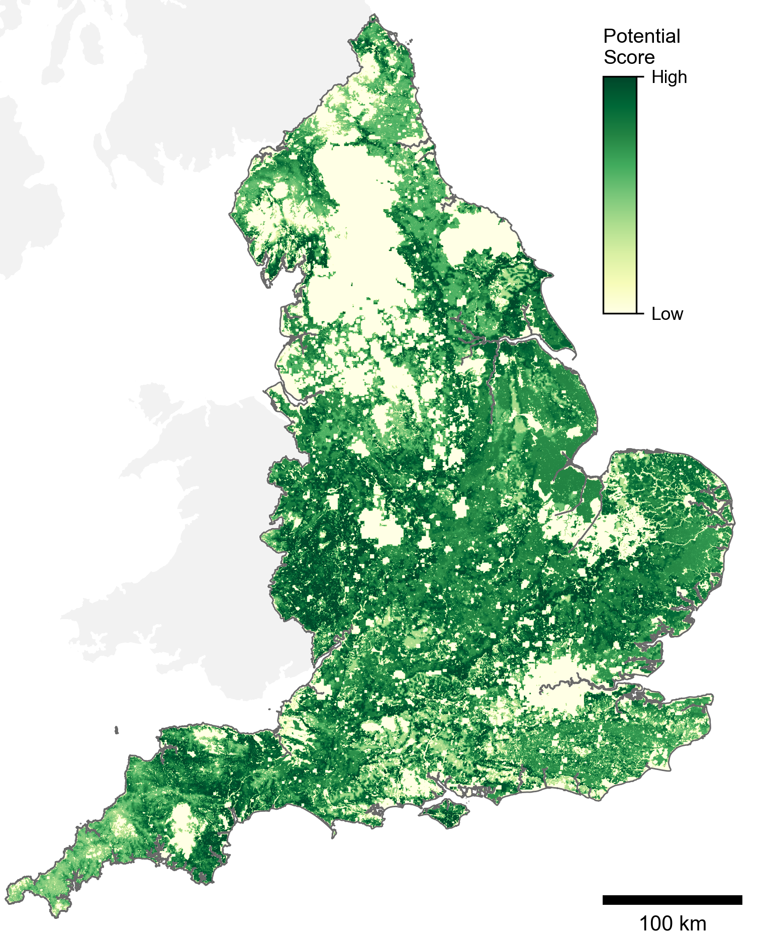
Summary of the Land Use Framework Why now, what is it, and how will it work?
What is a Land Use Framework?
A Land Use Framework is likely to comprise the principles needed to reform decision making, the capability (e.g. data, tools and resources) needed to apply those principles to practical decisions, and the policy to implement them and deliver a transformation of English land use.
How will it work?
The consultation was the critical first step to build public support for the transformation of English land use. We are developing proposals including on the Framework’s role in strategic spatial planning and the spatial targeting of policy delivery.
OFFICIAL SENSITIVE

Slide 7
We consulted for 12 weeks and aim to publish the Land Use Framework later this year
Land Use Consultation launches
Land Use Consultation closes
Minister-led roundtables
Regional workshops
Academia/Researcher workshops
(focus on analysis and evidence)
Analysis of consultation responses, informing policy development
12 weeks
January
February
March
April
May
June
July

