Slide 1
Planning Reform Weight for Minerals? …view from NE MPA
June 2025 Rob Murfin Director of Housing and Planning

Slide 2
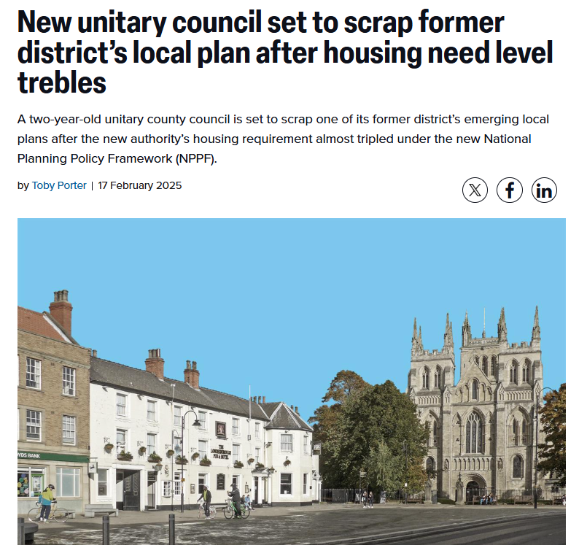
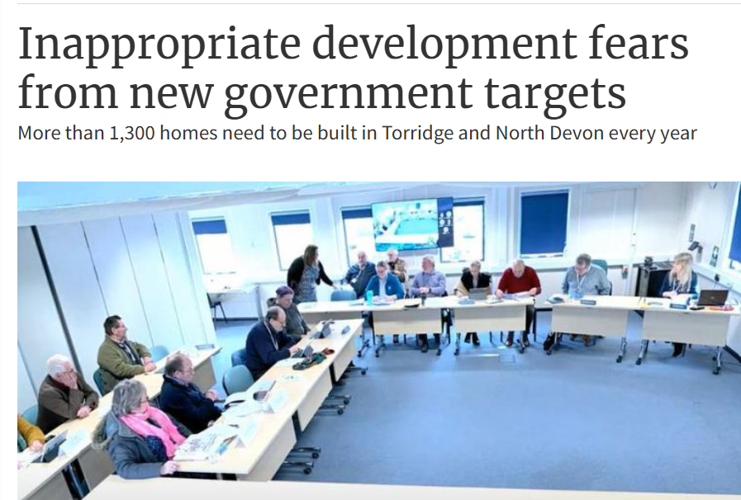
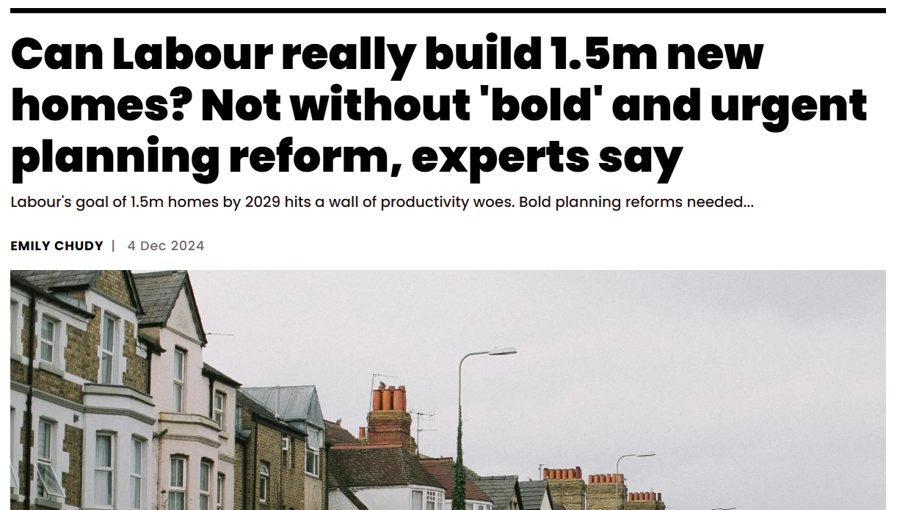
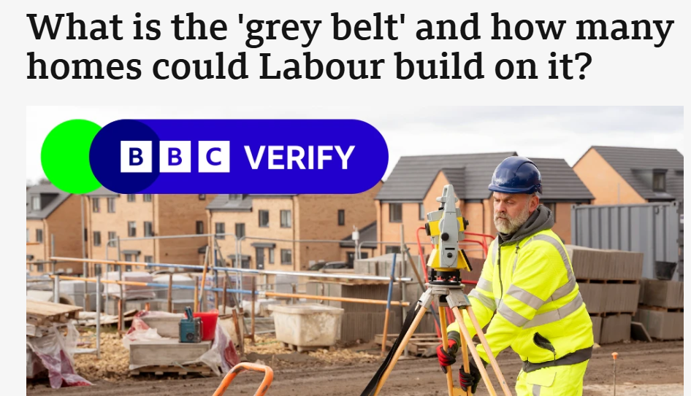
549 dpa >>> 1,649 dpa

Slide 3
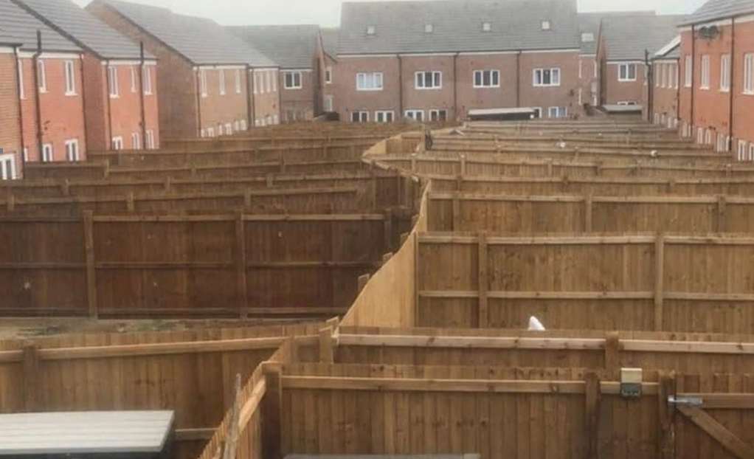
Local Housing “Need” Target
Errrrr… requires more elements in wider supply chain?

Slide 4
Local Housing Need Target
Affordable Housing Need
Demographic Need
Economic Need
Rural need
Non-Additionality Need/retrofit
Non-Hot-Spot Need
Specialist Housing Need
CONSEQUENTIAL IMMPLICATIONS OF GROWTH & INFRASTRUCTURE

Slide 5
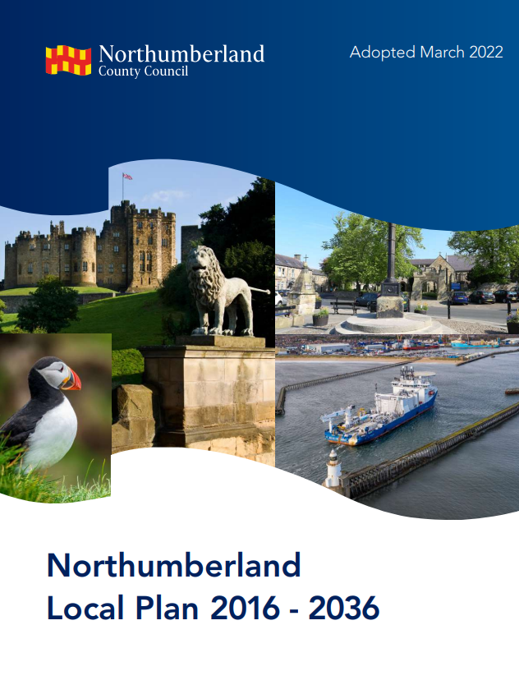
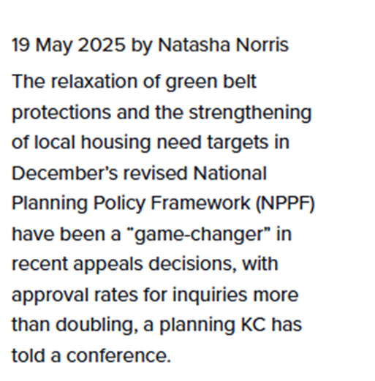
A Plan-led approach….?
Minimum of 82% of LAs will have out-of-of date local plan by late 2025, but this was before new targets….could be 91%+
Therefore, Gov has introduced clear mechanisms for non plan-led growth… such as grey belt
Gov do not just see this just about a “message”

Slide 6
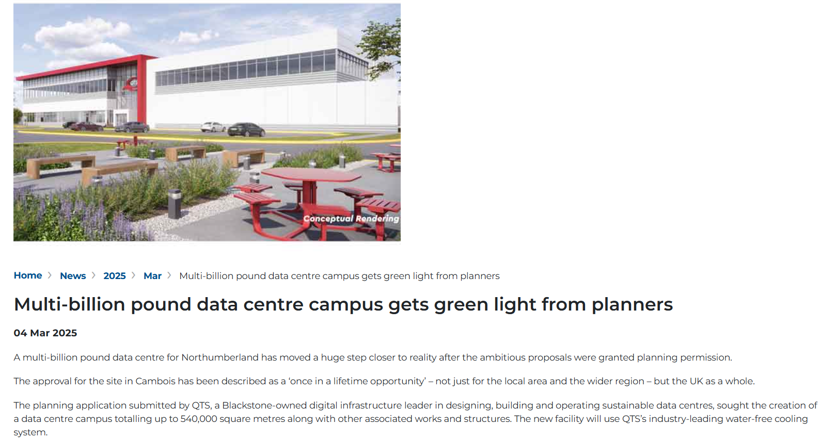
Other issues to include
Mixed housing economy required – inc “Faustian Pacts” = even higher targets…
Renewables/infrastructure
Economic development – large scale “on-shoring” and refit
Greenbelt is no longer sacrosanct …fuelling speculation where “unmet need” (lots of appeal decisions)
Scale of releases – Accretion vs Scale
540,000 SqM along with “associated works and structures”
CAs arguing for new railway lines and investment zones etc

Slide 7
But…. There always has been change
But all lured into special cases of “presumption against ” – on shore wind, OCCS…
Given Green Belt no longer sacrosanct, time to revisit some issues on minerals?

Slide 8
1. Evolution
National/ regional guidelines 2009, partly informed by AM2005. only period to 2020.
LAAs generally backward looking. We have moved away from this on regen..
Provision based on rolling average historic sales data “and other relevant local information”. Comfort zone.
Working with current system - need clear figures for each LA, with structure of strategic planning with bite to apportion figures to MPAs.
No robust method for locally calculated provision to meet “other relevant local information”

Slide 9
2. OR
Why engineer a system to plan for “least we can get away with”??
Would be more effective to assume the need for aggregate minerals?
…NPPF - LPAs should not require demonstration of overall need for renewable energy, instead give significant weight to the benefits
For every major minerals app found myself presenting coherent economic and strategic arguments – lots of reports published, but where is “so what” ???
(and if you are honest, it needs to works both ways…)
AND
Minerals strategy should be vision-led (to mirror economic development) (4.5x)

