Slide 1
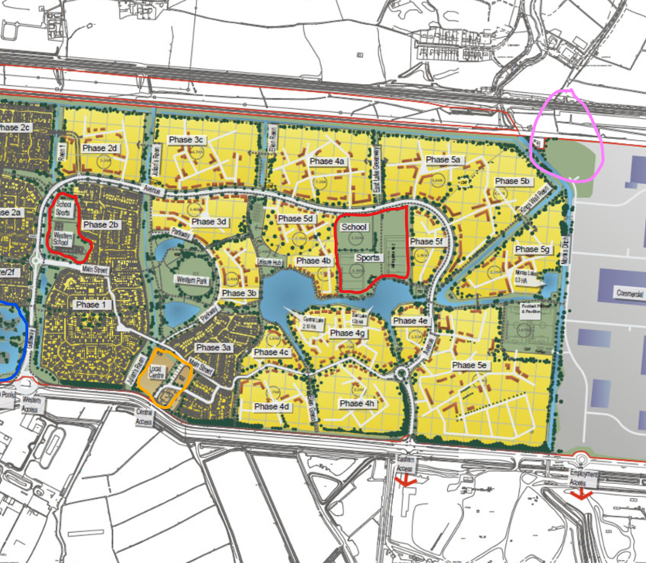
What is this?
Where is it?
Who uses it?
What is it for?
What issues might it produce?

