Slide 1
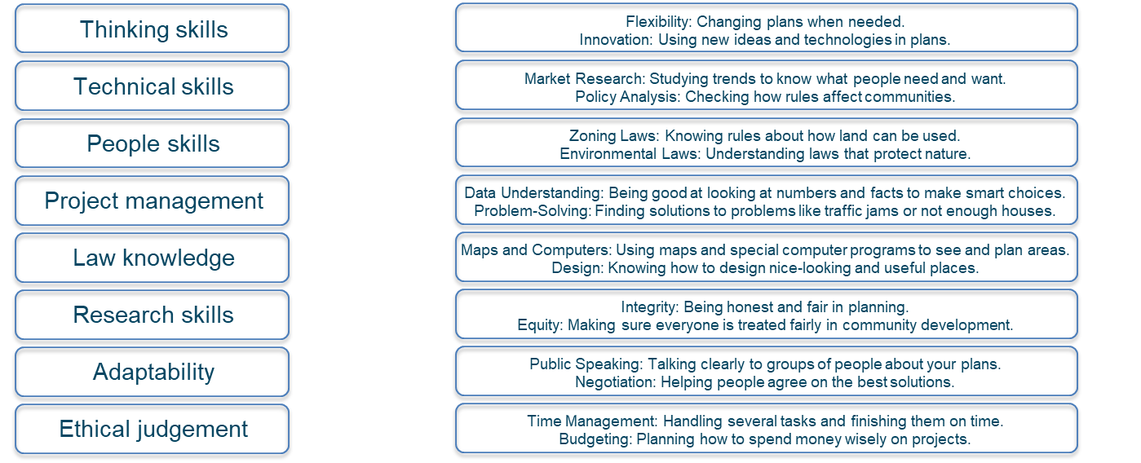
What makes a good planner?
Here are some of the key skills that a Planner must have.
Can you match up the skill with the correct definition?

Slide 2
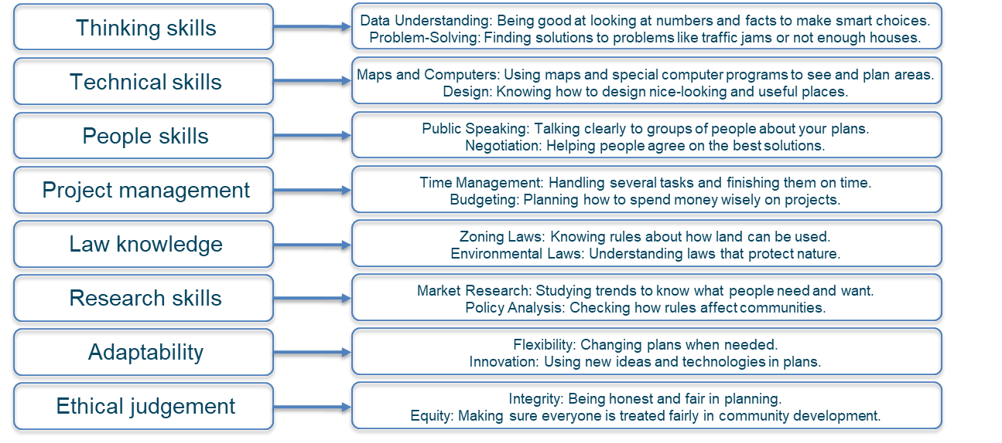
What makes a good planner?
Here are some of the key skills that a Planner must have.
Can you match up the skill with the correct definition?

