Slide 1
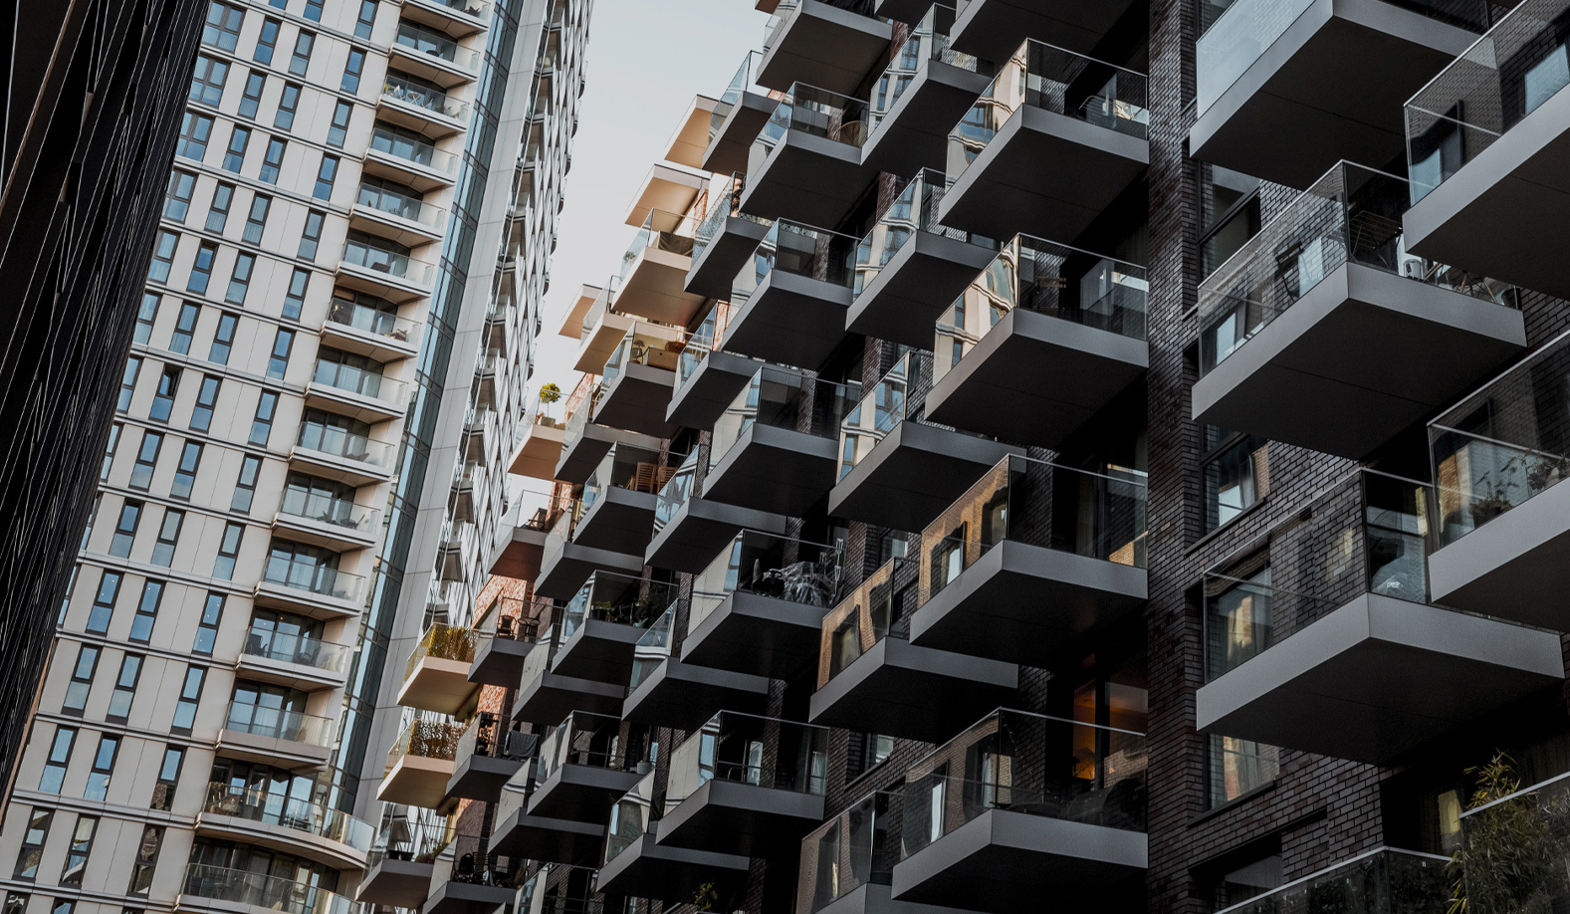

Enforcement of Conditions
RTPI Planning Enforcement Conference
  24 April 2025

Slide 2

  Meet the speaker
Mark O’Brien O’Reilly
Barrister at Francis Taylor Building

Slide 3
Interplay between a BCN and an EN - R (Liquid Leisure Ltd) v Royal Borough of Windsor and Maidenhead [2022] EWHC 1493 (Admin)
Green Belt site – PP granted to use the lake for waterskiing and windsurfing, and to install a clubhouse and boathouse
Other structures erected on the site – LPA issued an EN in late 2020 targeting a material change of use from waterskiing and windsurfing to a theme park with open water swimming and aqua jungle climbing
Whilst EN appeal in progress, LPA also issued a BCN alleging a breach of planning permission arising from buildings on the site without permission - the BCN overlapped with elements of the enforcement notice

Slide 4
Interplay between a BCN and an EN - R (Liquid Leisure Ltd) v Royal Borough of Windsor and Maidenhead [2022] EWHC 1493 (Admin)
Why did that matter? No right of appeal against the BCN so took effect whereas EN did not take effect until appeal determined
Developer challenged the BCN by way of Judicial Review in the High Court - alleged, inter alia, that decision to issue the BCN was unreasonable and an abuse of statutory powers
High Court held that LPAs had a wide discretion and that the statutory scheme did not make ENs and BCNs mutually exclusive
There was a risk for the LPA that the Appeal Inspector might not accept its argument re the operational development being integral to the MCU such that it could be removed even though four years had passed

Slide 5
Interplay between a BCN and an EN - R (Liquid Leisure Ltd) v Royal Borough of Windsor and Maidenhead [2022] EWHC 1493 (Admin)
In light of the risk that it might become immune, the BCN was issued so as to engage section 171B(3) – fall-back position for the LPA to prevent the unauthorised operational development becoming immune
High Court said the LPA was entitled to use its powers to achieve effective enforcement and was not required to reduce overlap between the BCN and enforcement notice, or to defer issuing the BCN until after the enforcement notice appeal
Fairness required, however, that compliance date for the BCN should be after the hearing of the EN appeal

Slide 6
Mast Quay Phase II and the use of conditions in a ground (a) appeal
Mast Quay Phase II – 204 residential units (one 15 storey tower block and a second 23 storey tower block with link tiered 11, 9 and 6 storeys along with associated devl) in Woolwich
Two previous grants of planning permission – one grant of planning permission for a development in March 2012 and a subsequent s73 planning permission in April 2015
Constructed development did not resemble the approved plans - significant deterioration in the quality of the development

Slide 7
Identifying the breach of planning control
What was the breach of planning control? The whole development in its entirety or the individual deviations from the approved scheme? Or a breach of condition in respect of approved plans?
Required consideration of caselaw like Commercial Land Ltd v Secretary of State for Transport, Local Government and the Regions [2002] EWHC 1264 (Admin)
EN (September 2023) said that the development, when considered objectively and as a whole, was so materially different from the development which had been authorised by the previous grants of planning permission that it did not constitute the lawful implementation of either of those permissions - the whole of the development was unlawful as it was constructed without planning permission

Slide 8
The EN appeal
By the time of the appeal, it was common ground with the Appellant that the entirety of the development was unlawful as neither permission had been lawfully implemented
Appeal initially made on grounds (a), (b), (c), (f) and (g)
The effect of the ground (a) appeal was that the Inspector had to determine, therefore, a deemed application for planning permission
It was this ground that the appeal became focussed on

Slide 9
The ground (a) appeal and the decision
Ground (a) appeal included significant changes to the development which the Appellant called “Optional Enhancements” and “Outstanding Proposals” (expanded during the inquiry)
In his DL (9 January 2025), the Inspector said that it was an important planning principle that if a concern could be overcome by a condition, planning permission should not be withheld
Concluded that planning permission could be granted on the ground (a) appeal if it were made subject to 50 conditions to ensure the modification of the unlawful development and provide necessary mitigation

Slide 10
The conditions
Wide ranging in their scope - require significant changes to the development, e.g. replacement of the external cladding, changes to the roof treatment and inclusion of air cooling systems as well as fire safety related improvement works, etc
If any of those conditions are not complied with, the sanction will be that the Appellant will have to comply with the requirements of the upheld Enforcement Notice and remove the development
Inspector described this approach as keeping the “ultimate sanction”, i.e. demolition and remediation, in place – aim is to ensure the Appellant implements the planning permission in accordance with the conditions

Slide 11
Example of one of the conditions
Condition Four:
The development hereby permitted shall cease its residential and commercial uses and all requirements of the upheld enforcement notice shall be carried out within 36 months of the date of failure to meet any one of the requirements set out in (a) to (d) below:
    a. Within 3 months of the date of this decision details of facing materials and finishes to be used on the proposed elements, including samples and manufacturer’s specifications and, other than materials for landscaping works pursuant to condition 18, shall have been submitted for the written approval of the Local Planning Authority.
    b. If within 9 months of the date of this decision the Local Planning Authority refuse to approve the details or fail to give a decision within the prescribed period an appeal shall have been made to, and accepted as valid by, the Secretary of State.
    c. If an appeal is made in pursuance of (b) above, that appeal shall have been finally determined and the submitted details shall have been approved by the Secretary of State.
    d. The approved details shall have been carried out and completed in accordance with the approved timetable.

Slide 12
DISCLAIMER NOTICE The oral presentation including answers given in any question and answer session (“the presentation”) and this accompanying paper are intended for general purposes only and should not be viewed as a comprehensive summary of the subject matters covered. Nothing said in the presentation or contained in this paper constitutes legal or other professional advice and no warranty is given nor liability accepted for the contents of the presentation or the accompanying paper. Craig Howell Williams, Mark O'Brien O'Reilly and Francis Taylor Building will not accept responsibility for any loss suffered as a consequence of reliance on information contained in the presentation or paper. We are happy to provide specific legal advice by way of formal instructions.

