Slide 1
Case Law Update April 2025
Scott Stemp
ss@no5.com
planning@no5.com

Slide 2
West Suffolk Council v. SoSLUHC and others [2025] EWHC 861 (Admin)
Class E

Slide 3
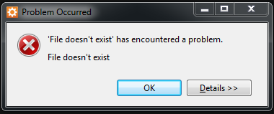
Paton v. SoSLUHC and another [2025] EWHC 245 (Admin)
Breach occurring?

Slide 4
Titchfield Festival Theatre Ltd v. SoSLUHC and another [2025] EWHC 883 (Admin)
Planning units
Planning chapters
Surviving uses?

Slide 5
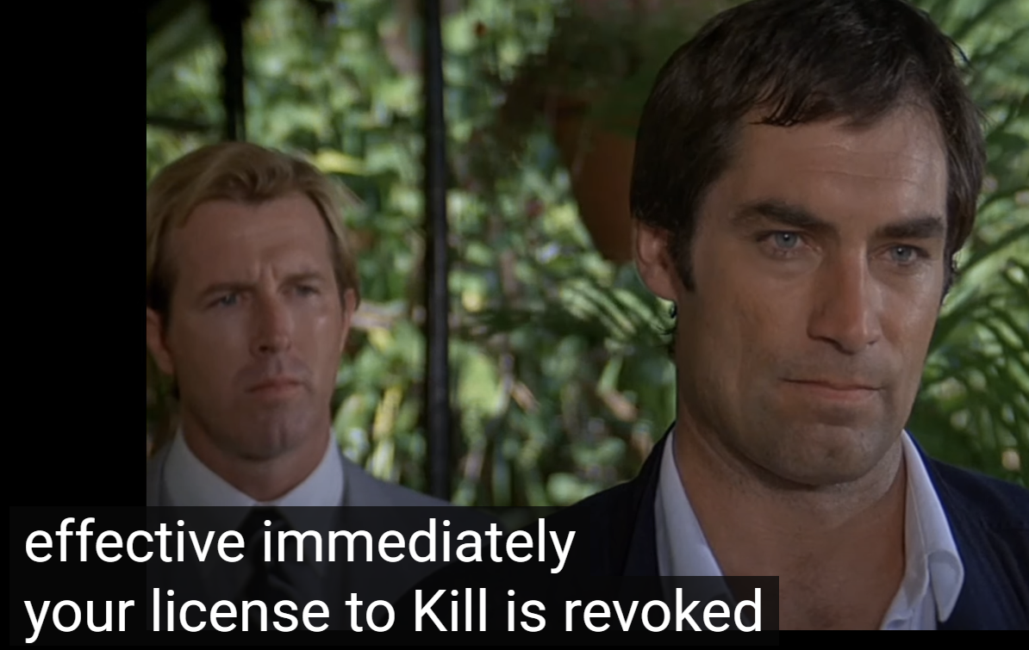
Ocean One Hundred [2025] Mehta [2024]
Revocation of certificates

Slide 6
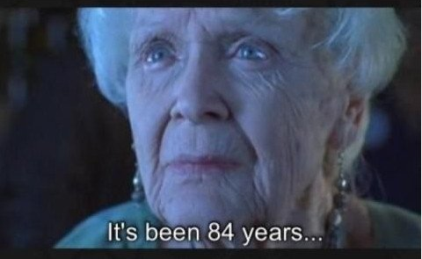
SoSLUHC v. Rogers [2024] EWCA Civ 1554
Service

Slide 7
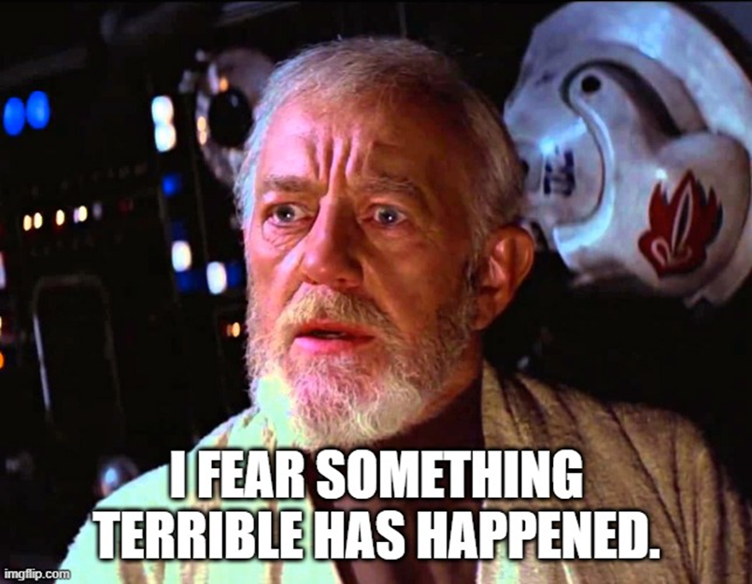
Jones v. Isle of Anglesey County Council and another [2024] EWHC 2582 (Admin)
Change of use

Slide 8
Case Law Update April 2025
Scott Stemp
ss@no5.com
planning@no5.com

