Slide 1


IVY TRAINING
For Planning Professionals
CHANGING PERSPECTIVES: Appeal Tips – 24 April 2025

Slide 2

Perspectives on defending appeals
Focus on the following:
Appeal statements and procedures
Warning notices and ground (a) barring
Keeping an eye on undue delay and costs

Slide 3
Appeal statements
&
Procedures
from an ex-Inspector's perspective

Slide 4

Statements & delegated reports
Time is critical – question isn’t how long should I take to write the statement/proof, but how long does the Inspector have to read the file?
Tackle the GoA in a structured way: in the order the Inspector will write the decision or report: e, b, c, d, a, f, g
Make sure you understand the relevant test in each GoA
Understand the appellant’s case but give reasons & examples – make a compelling case based on evidence and focus on disagreements
no need to repeat stuff or dwell on irrelevant matters – focus on how relevant policy should be applied or how the GoA should be determined
Do cover each issue/reason for issuing the notice but acknowledge opposing arguments
Do keep appendices separate for ease of reading/reference
Do use sub-headings and/or bullet points
Make time to review appellant statements and
Send final comments if there is a need.

Slide 5

Statements & reports
Do check very carefully the EN is in order – might there be a challenge to its validity? Does it need correcting – can both parties agree the corrections before the event? Is there anything need addressing with the site plan? Injustice?
Inquiry – what’s the point of the SoC?
Statement of common ground / uncommon ground
Aware of PINS use of AI / alert to use of AI in evidence
Quality v quantity - reasons why the appeal should be dismissed
A word on Delegated reports
Structure, reasons, expediency
Should we publish the officer or expediency reports?

Slide 6

Ensuring equality of arms…
Late evidence
Do you challenge the submission of late documents or evidence?
Be prompt
Alert
Challenge perceived biasness
Raise matters in a timely manner for example, new or emerging policy, relevant decision made on the same site/adjoining site
Issues with the EN or site plan – suggest solutions
Is it related to a change in circumstances
Covered by evidence already received
Is it directly relevant &
procedurally fair to all parties
Does the Inspector maintain equality of arms…
Are they discharging their inquisitorial burden?
Is there a need for legal representation – do you ask for your own legal rep or just continue with the event?
CMCs - procedural but are you being told the EN is wrong? Why?
Do you raise the possibility of a costs application?
Use of discretionary power to vary requirements / period of compliance

Slide 7
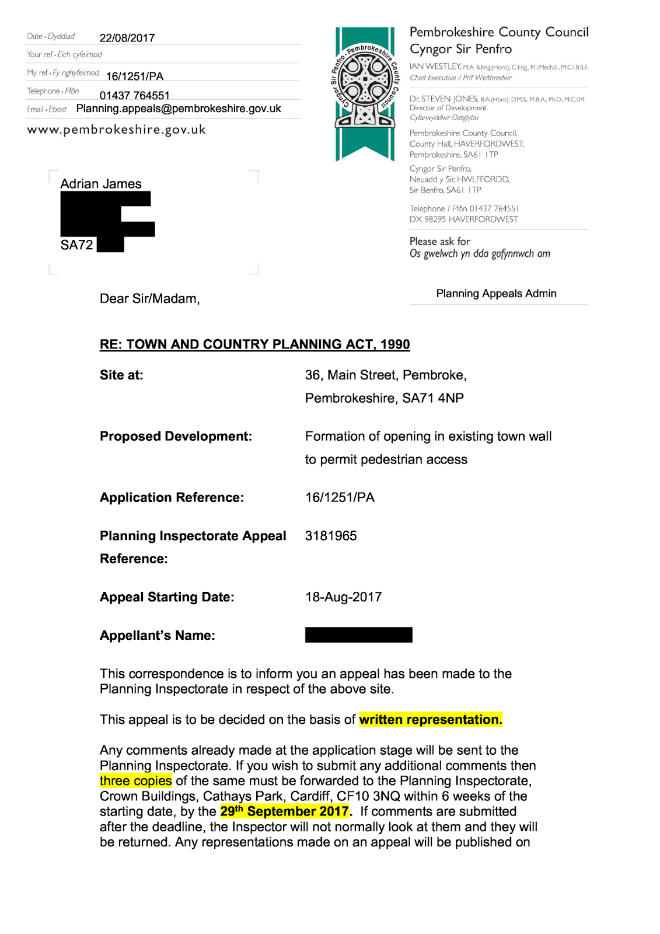
Getting notification right
Make sure you get the notification right
It takes time to send corrected notifications out if we don’t get them right first time
Ensure the letter includes:
a description of the alleged breach of planning control
a statement of its reasons for issuing the notice
the steps required to be taken by the enforcement notice
the appellant’s grounds of appeal against the notice
the appeal procedure
an invitation to interested people to make their views known by submitting their views online through the ACP portal

Slide 8
Questionnaires
Flag planning applications for the same site/development – Part 4 of the questionnaire – relevant to ground (a) barring
Is the appeal determined via the right procedure – if no, have you looked at the criteria and given reasons
Make sure copies of all relevant documents & policy are submitted
If you are not submitting a statement, tell PINS (case officer), but you may want to update the officer report because of the GoA at statement of case time
What about list of suggested conditions where there is a g(a) or s78 appeal? Or do you feel conditions should not be submitted?

Slide 9
Warning notice
&
Ground (a) barring

Slide 10

Enforcement warning notice… what is the point
Where it appears that — (a) there has been a breach of planning control, and (b)there is a reasonable prospect that, if an application for planning permission in respect of the development concerned were made, planning permission would be granted.
Reasonable prospect of PP granted vs unlikely to be granted
The issue of an EWN constitutes taking enforcement action - for the purposes of section 171B time limits

Slide 11

Ground (a)…
No appeal under ground (a) may be made if:
the enforcement notice was issued after the making of a
related retrospective planning application
&
(2) within 2 years of the date on which the
related application ceased to be under consideration… BUT
There will only be one bite at the cherry… Closing loopholes to limit opportunities to obtain planning permission
How do we ensure PINS is made aware of a planning application for the development subject to enforcement action?
Rely on human intervention or technology ?
If you think ground (a) is barred, speak up & tell PINS
What does this mean in practice..?

Slide 12
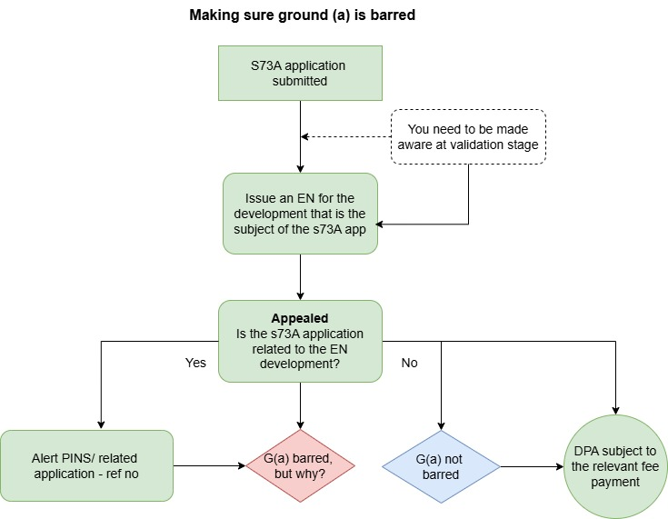
G(a) – simple case ...
It isn’t always straightforward...

Slide 13
PPG – is it helpful?
An application has ceased to be under consideration if: | Day on which consideration ceased
A related application was refused or granted subject to conditions and there was no appeal against that decision (where an appeal route is available) | Day on which the right to appeal arose (i.e. the day on which the decision on the related application was made)
A related application was not determined and there was no appeal against that non-determination | Day after the end of the statutory determination period for the related application
An appeal against the decision on the related application was made | Day on which the appeal was dismissed
An appeal against non-determination of the related application was made | Day on which the appeal was dismissed
An application was on appeal granted subject to conditions, or subject to different conditions | Day on which the appeal was determined
The Secretary of State declined to determine an appeal using his powers in section 79(6) of the TCPA in respect of a related application which was refused or granted subject to conditions | Day on which the right to appeal arose (i.e. the day on which the decision on the related application was made)
The Secretary of State declined to determine an appeal using his powers in section 79(6) of the TCPA in respect of a related application which had not been determined | Day after the end of the statutory determination period for the related application

Slide 14

G (a) – barred or not
What does “related development” mean?
A related application is one where, if planning permission were granted for the development specified in the application, it would grant planning permission for the development which is the subject of the enforcement notice
It is possible for the development in the related application to be more extensive than that contained in the enforcement notice
Manchester City Council v. The Secretary of State Levelling Up, Housing and Communities [2022] EWHC 1062 (Admin) – a case before the rule change but the rule change adopts the HC’s findings…

Slide 15


Manchester & related development
Developer applies for PP - development to a dwelling “Change of use of the ground floor to a shop and extension of the property to create a 3-bed flat”
The LPA issues EN in respect of the first-floor extension and roof dormer and, the following day, refuses the planning application…
Developer appeals the EN saying that PP ought to be granted for the matters constituting the breach of planning control stated in the notice…
LPA promptly writes to PINS saying the application is in part-retrospective - the erection of a first-floor rear extension and installation of a rear roof dormer…
The LPA argue that G(a) is barred - because the EN development (the erection of the first-floor extension and installation of the rear roof dormer) is the same as that for which the retrospective part of the planning application had been refused…
Discuss - is G(a) barred?

Slide 16
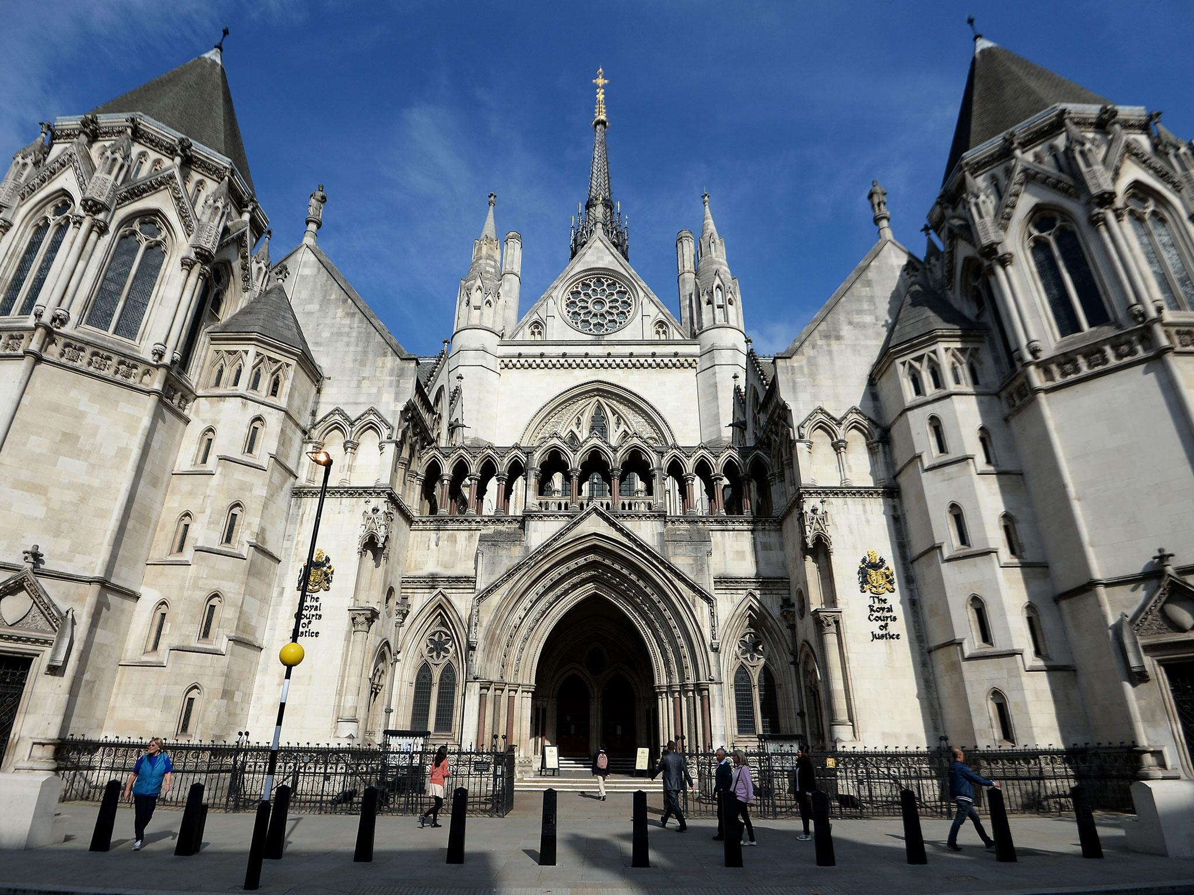
PINS disagrees with the LPA - the substance of the development which had been considered under the planning application was significantly different to that which would be considered under the G(a) appeal – why?
Because the application had involved consideration of the matters enforced against in terms of facilitating the material change of use to create a three-bedroom flat, rather than as just being part of the existing dwelling, and that the planning application was therefore not a “related application” for the purposes of section 174(2A) and (2B)..
PINS issues an order validating the developer’s ground (a) and (f) appeal but the LPA challenge that validation (s289 challenge)

Slide 17
lesson to take from the judgment…
on the plain and ordinary meaning of section 174(2B) the test for “related development” was met where the grant of permission on the application would have the effect of authorising and regularising all the development now being enforced against, and
while section 174(2A) and (2B) required that everything covered by the EN had to fall within the ambit of the hypothetically granted planning application, they did not require exact coincidence between the matters specified in the EN and the development for which PP had been sought but, on the contrary, envisaged that PP for the development could be greater than the PP in respect of the EN matters…
Hence the PPG advice that… It is possible for the development in the related application to be more extensive than that contained in the enforcement notice (paragraph: 013 Reference ID: 17b-013-20140306)

Slide 18
Costs
&
Undue delay

Slide 19

Undue delay - don’t get caught out
Power to dismiss (chuck out!) appeals where a customer causes undue delay in enforcement/LDC appeal
LPA doesn’t submit questionnaire or statement, or any document required by regulations despite chasing
Appellant fails to submit supporting information or statement required
Failure to agree a date for an oral event
Repeated adjournment requests
Failure to turn up to an event (SV, H, LI)
Non-compliance with procedure
Any other…

Slide 20

A word on costs
Withdrawing EN without good reason
Should Council’s make more applications for costs?
Basis of a decision – was the behaviour unreasonable and even if it was, did
cause unnecessary waste and expense?
Focus on the behaviour and not irrelevant matters e.g. sending in late evidence, evolving / changing / adding grounds of appeal?
The PPG example of kind of unreasonable behaviour is not an exhaustive list
Unreasonable behaviour – documented / evidenced
Introducing new grounds or making arguments implying a hidden GoA
Wasted or unnecessary expense - are we able to identify how much time has gone in responding to new GoA or late documents
The role of agents?

Slide 21
Any thoughts
reflections
or
questions

